Slide 1

Long Term Growth Trajectory of the Indian Aviation Industry Discounting COVID 19 Disruptions
Returning to Altitude
86052200019 | A014 | Abhishree Agarwal
86052200037 | A029 | Divyansha Sachdeva
86052200045 | A035 | Manasvi Kadhi
86052200051 | A038 | Keval Mehta
86052200061 | A045 | Shashwat Modi
Under the valuable guidance of Dr. Rushina Singhi
Semester 5 | B.Sc. Applied Statistics and Analytics | Time Series Analysis

Slide 2
Flow of the Presentation
S. No. | Title | S. No. | Title
1 | Review of Literature | 6 | Insights Panel
2 | Tools Used | 7 | Findings
3 | Research Methodology | 8 | Conclusion
4 | Overview of the Data | 9 | Future Scope
5 | Objectives | 10 | References

Slide 3
Review of Literature
S. No. | Title | Author(s) | Journal (Year) | Summary
1 | Taking flight: exploring the relationship between air transport and Malaysian economic growth | Asif Raihan, Liton Chandra Voumik et al. | Elsevier Journal of Air Transport Management (2024) | This study uses the ARDL framework to confirm that air transport significantly drives Malaysia's economic growth from 1970 to 2020, with additional contributions from energy use, financial development, social globalisation, and urbanisation.
2 | Time series based road traffic accidents forecasting via SARIMA and Facebook Prophet model with potential changepoints | Edmund F. Agyemang, Joseph A. Mensah et al. | CellPress Heliyon (2023) | This study compares SARIMA and Facebook Prophet models for forecasting road traffic accidents in Ghana, finding SARIMA to be more accurate in capturing seasonal patterns and recommending it for effective time series analysis.
3 | A comparative study on application of time series analysis for traffic forecasting in India: prospects and limitations | Kartikeya Jha, Nishita Sinha et al. | JSTOR Current Science Association (2016) | This study compares time series analysis with traditional forecasting methods for traffic in India, highlighting its accuracy advantages for larger datasets and examining how data proximity affects forecast precision.
4 | Enhancing prediction and analysis of UK road traffic accident severity using AI: Integration of machine learning, econometric techniques, and time series forecasting in public health research | Md Abu Sufian, Jayasree Varadarajan, Mingbo Niu | CellPress Heliyon (2024) | This study combines machine learning, econometrics, and time series models (ARIMA, GMM, XGBoost) to predict UK road accident severity, using SHAP for insights and offering policy recommendations to enhance road safety.

Slide 4







Tools Used
Microsoft
Excel
Microsoft
Word
Python
Indiastat
Google Drive
R
Microsoft
PowerPoint

Slide 5
Research Methodology
Linear Regression
A statistical method to model the relationship between a dependent variable and one or more independent variables by fitting a linear equation.
AutoRegressive Integrated Moving Average
A time series forecasting technique that combines autoregression, differencing, and moving averages to model and predict future values.

Slide 6
Research Methodology
Seasonal ARIMA
An extension of ARIMA that includes seasonal components, useful for time series data with seasonal patterns.
Facebook Prophet
A forecasting tool developed by Facebook, designed for time series data with daily observations and strong seasonal effects, offering robust handling of missing data and outliers.

Slide 7
Overview of the Data
Aviation Industry
Hours Flown
Hot Air Balloons
Airplanes
Helicopters
Number of Departures
Passengers Carried
Revenue Generated
Hours Flown
Number of Departures
Passengers Carried
Aircraft Movement
Freight Movement
Passenger Movement
Fleet Size
Market Share
Hours Flown
Kilometres Flown
Passengers Carried
Passenger Load Factor
Pilot Licences Issued
Profit and Loss

Slide 8
Overview of the Data
Aviation Industry
Hours Flown
Hot Air Balloons
Airplanes
Helicopters
Number of Departures
Passengers Carried
Revenue Generated
Hours Flown
Number of Departures
Passengers Carried
Aircraft Movement
Freight Movement
Passenger Movement
Market Share
Fleet Size
Hours Flown
Kilometres Flown
Passengers Carried
Passenger Load Factor
Pilot Licences Issued
Profit and Loss
Non Pawan Hans
Pawan Hans
Airport-wise
Airline-wise
Overall

Slide 9
Objectives
Identify trends and seasonality in aviation data across airplanes, helicopters, and hot air balloons.
Compare forecasting model accuracy (Regression, ARIMA, SARIMA, Facebook Prophet, Exponential Smoothing).
Assess COVID-19's long-term impact by comparing 2019-24 actual vs. forecasted data.
Extend forecasts beyond 2013 for historical datasets.
Conduct EDA on profit/loss, market share, fleet size, and pilot licences issued.
Compare aviation industry growth with national GDP trends, including COVID-19 effects.

Slide 10
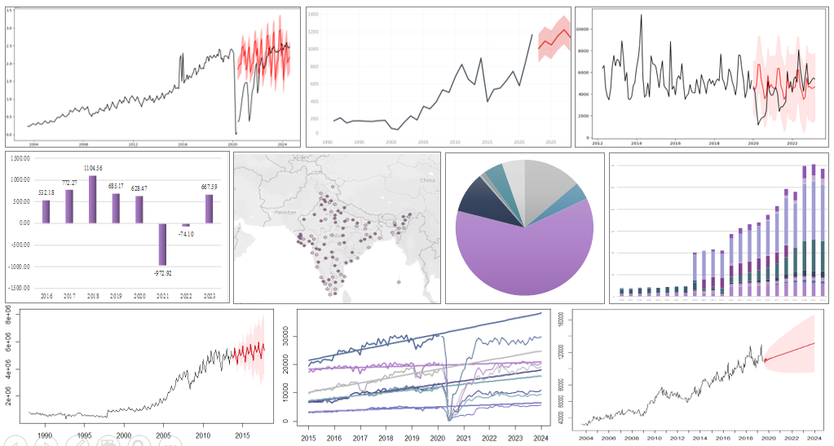
Insights Panel

Slide 11
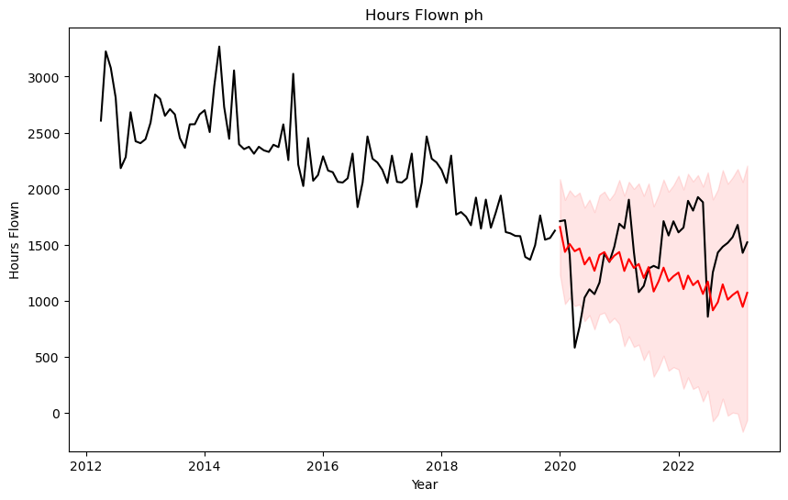
SARIMA
1.1.1. Pawan Hans Helicopters Hours Flown
COVID comparison is depicted here.
Decreasing trend is present.
Seasonality is present.

Slide 12
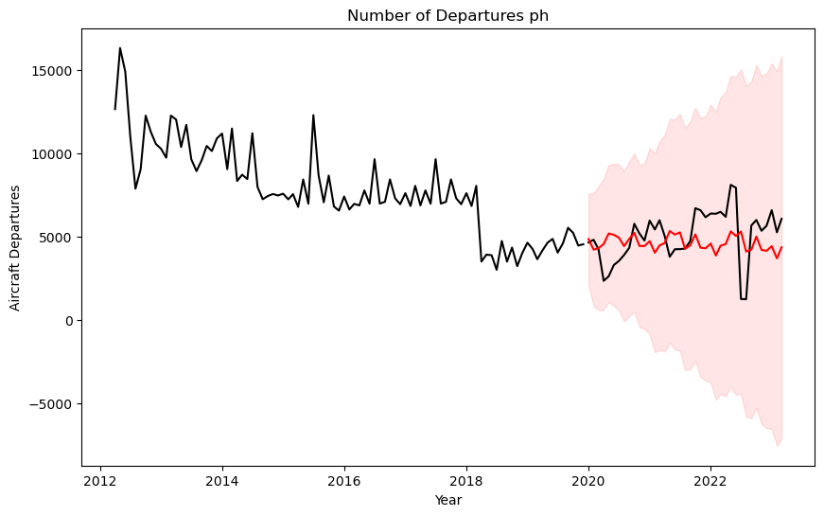
SARIMA
1.1.2. Pawan Hans Helicopters Number of Departures
COVID comparison is depicted here.
Decreasing trend was present.
Seasonality is present.

Slide 13
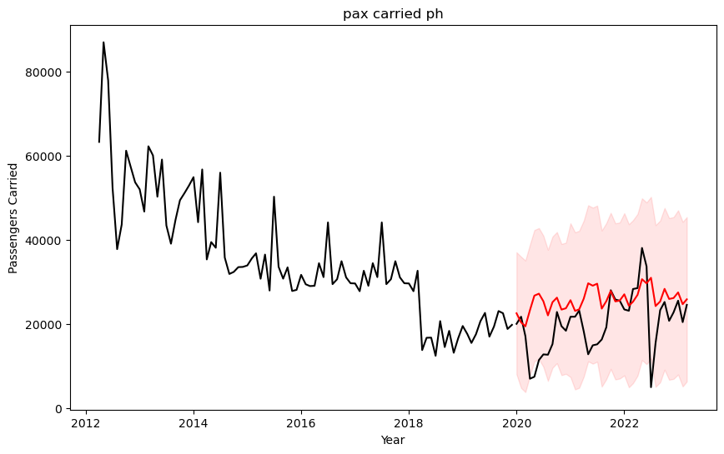
SARIMA
1.1.3. Pawan Hans Helicopters Passengers Carried
COVID comparison is depicted here.
Decreasing trend was present.
Seasonality is present.

Slide 14
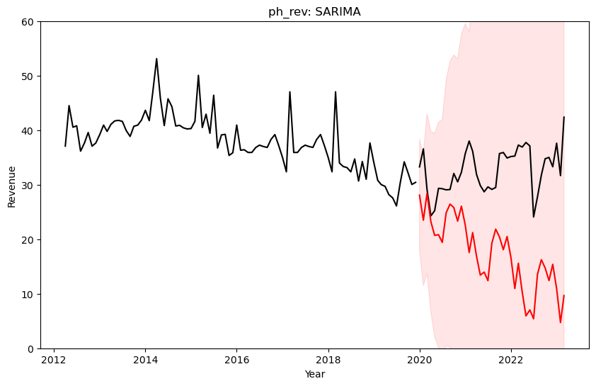
SARIMA
1.1.4. Pawan Hans Helicopters Revenue Generated
COVID comparison is depicted here.
Decreasing trend is present.
Seasonality is present.

Slide 15
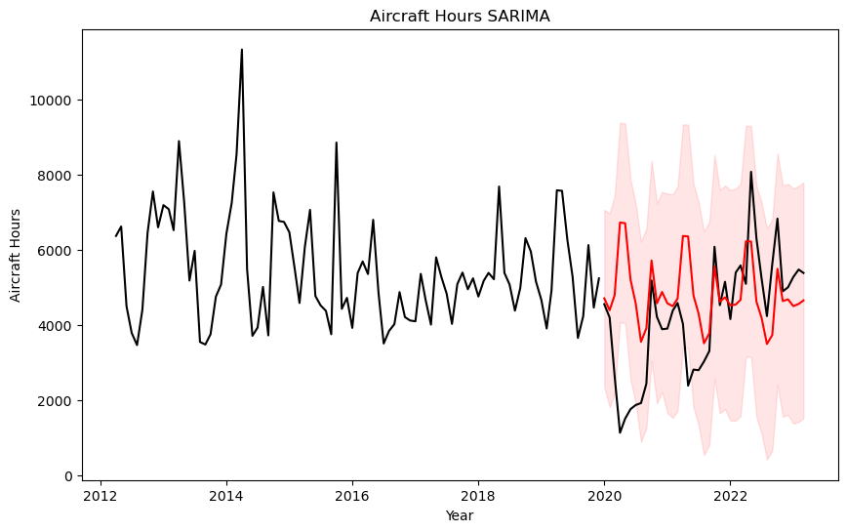
SARIMA
1.2.1. Non-Pawan Hans Helicopters Hours Flown
COVID comparison is depicted here.
No trend is present.
Seasonality is present.

Slide 16
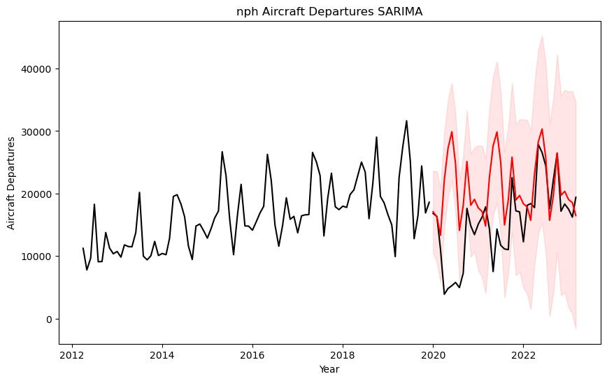
SARIMA
1.2.2. Non-Pawan Hans Helicopters Number of Departures
COVID comparison is depicted here.
No trend is present.
Seasonality is present.

Slide 17
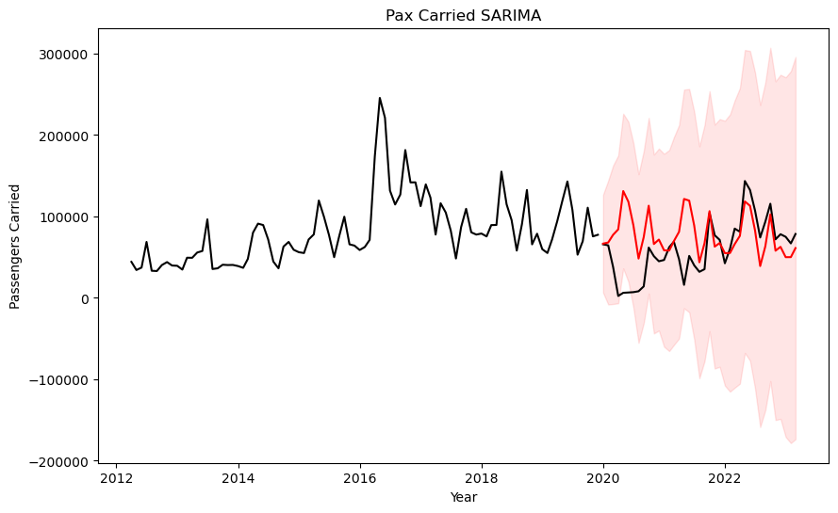
SARIMA
1.2.3. Non-Pawan Hans Helicopters Passengers Carried
COVID comparison is depicted here.
No trend is present.
Seasonality is present.

Slide 18
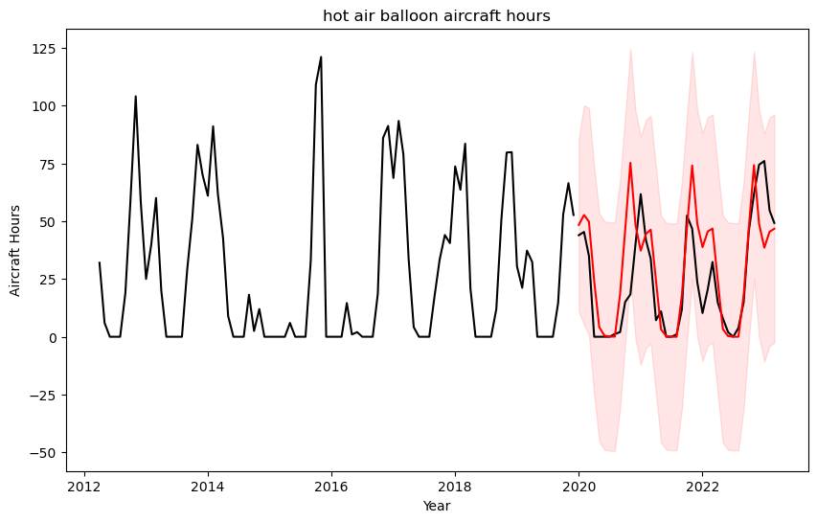
SARIMA
2.1. Hot Air Balloons Hours Flown
COVID comparison is depicted here.
No trend is present.
Seasonality is present.

Slide 19
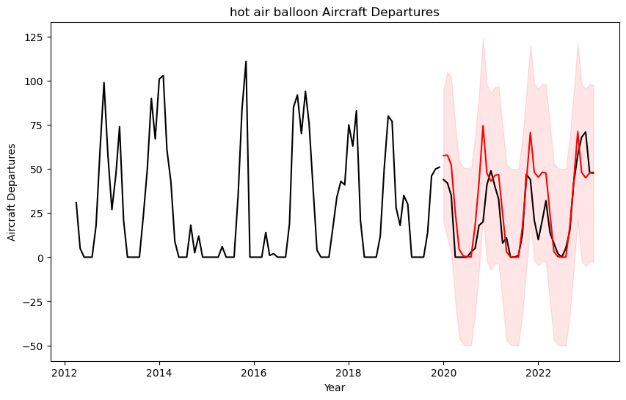
SARIMA
2.2. Hot Air Balloons Number of Departures
COVID comparison is depicted here.
No trend is present.
Seasonality is present.

Slide 20
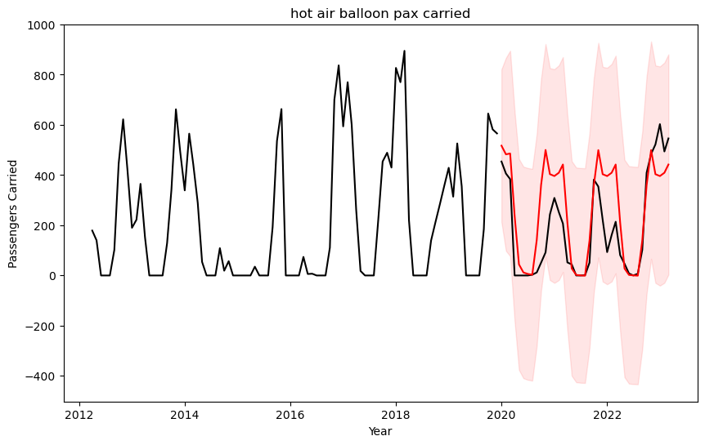
SARIMA
2.3. Hot Air Balloons Passengers Carried
COVID comparison is depicted here.
No trend is present.
Seasonality is present.

Slide 21
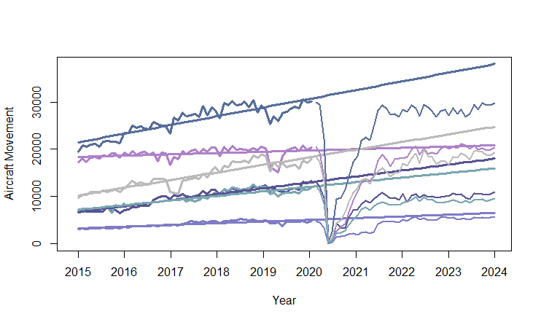
Linear Regression
3.1.1. Airport-wise Aircraft Movement
y = 21304.0232 + 166.2212x
y = 10084.2049 + 145.2031x
y = 18359.4054 + 24.5571x
y = 6563.8734 + 113.2578x
y = 7090.9953 + 87.5564x
y = 3183.99185 + 31.61311x
Delhi
Mumbai
Kolkata
Bengaluru
Chennai
Pune

Slide 22
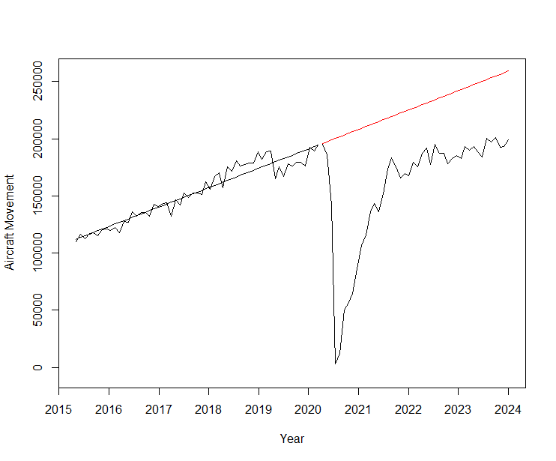
Linear Regression
3.1.2. Aggregate Aircraft Movement
COVID comparison is depicted here.
Increasing trend is present.
Seasonality is present.

Slide 23
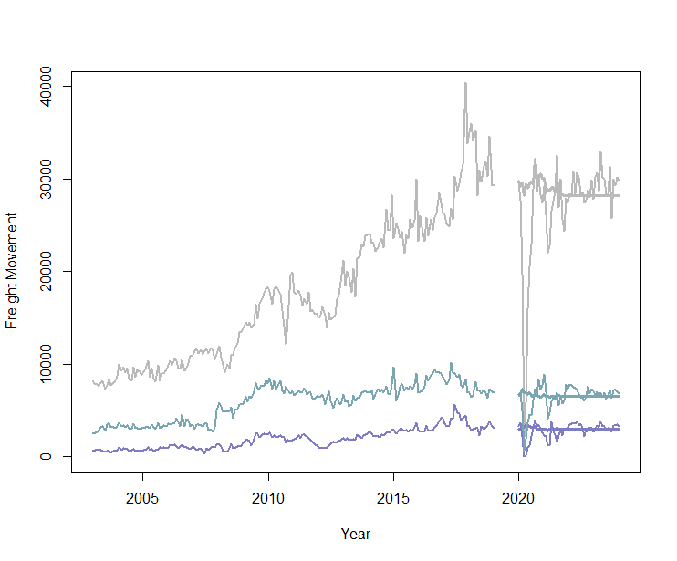
ARIMA
3.1.3. Airport-wise Freight Movement
COVID comparison is depicted here.
Increasing trend is present.
Seasonality is present.
Freight Movement (in Tonnes)
Delhi
Chennai
Pune

Slide 24
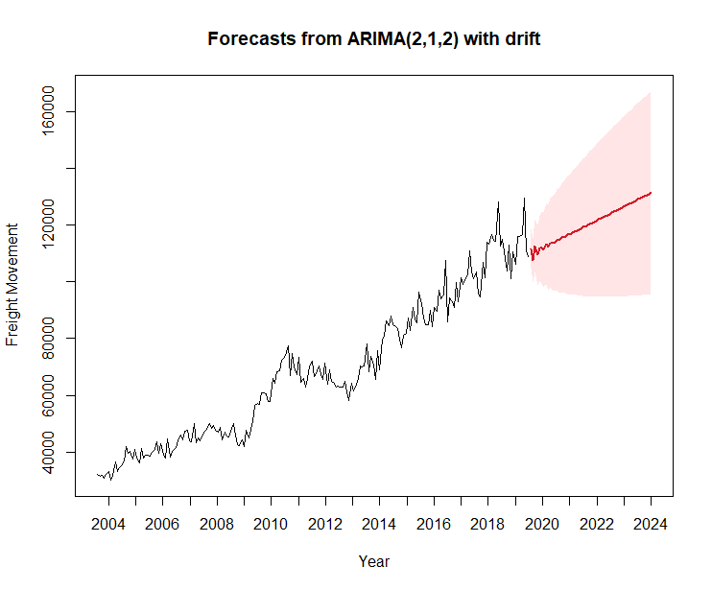
ARIMA
3.1.4. Aggregate Freight Movement
Data is forecasted from the year 2020 to 20__ here.
Increasing trend is present.
Seasonality is present.
Data is forecasted from 2020 to 2024 here.
Increasing trend is present.
Seasonality is present.
Freight Movement (in Tonnes)

Slide 25
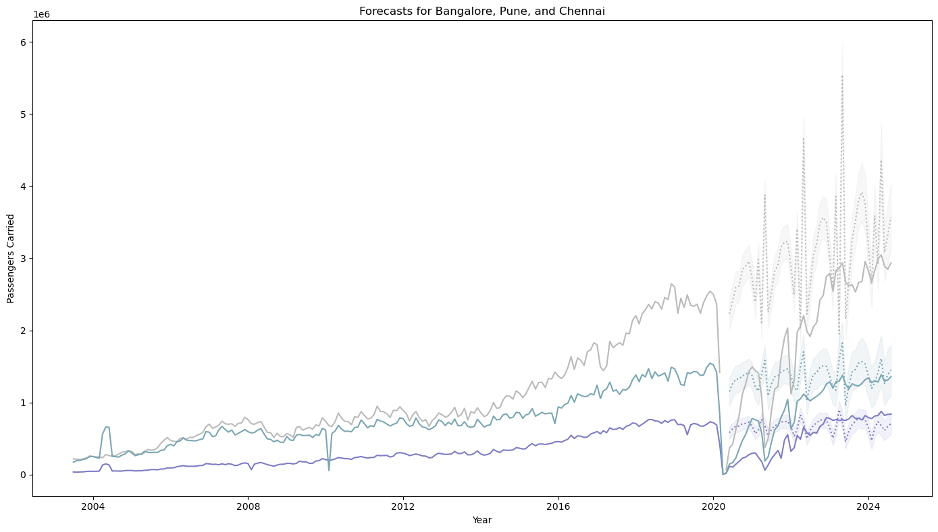
Facebook Prophet
3.1.5. Airport-wise Passenger Movement
COVID comparison is depicted here.
Increasing trend is present.
Seasonality is present.
Unlike Bengaluru, Chennai and Pune have caught up with the forecast.
Passenger Movement
Bengaluru
Chennai
Pune
Year

Slide 26
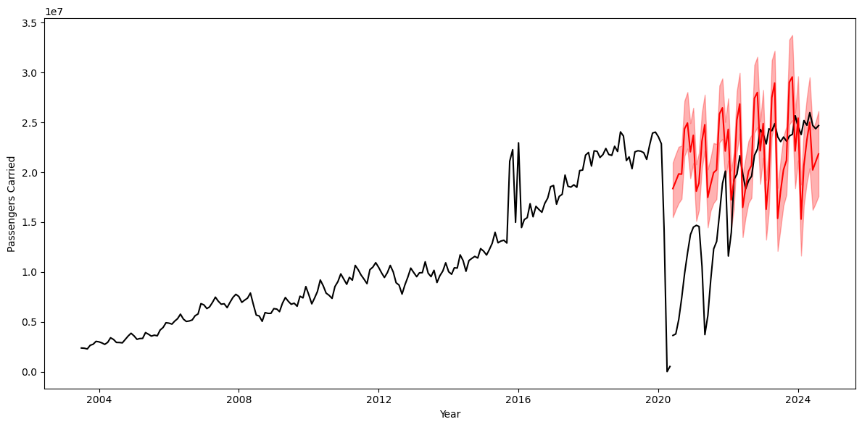
Facebook Prophet
3.1.6. Aggregate Passenger Movement
COVID comparison is depicted here.
Increasing trend is present.
Seasonality is present.
Passenger Movement
Year

Slide 27
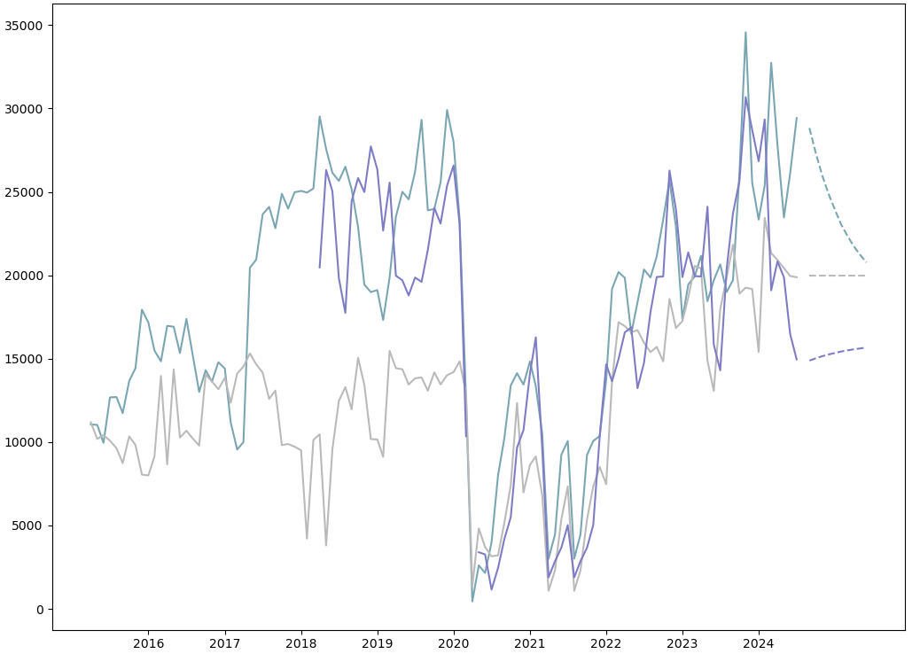
ARIMA
3.1.7. City Pair-wise Passenger Movement
Pair-wise passenger movement is forecasted for the next 12 months here.
BLR – BOM show a decreasing trend, while the other two show an increasing one.
Seasonality is present.
Passenger Movement
Bengaluru - Chennai
Bengaluru - Mumbai
Kolkata - Pune
Year

Slide 28
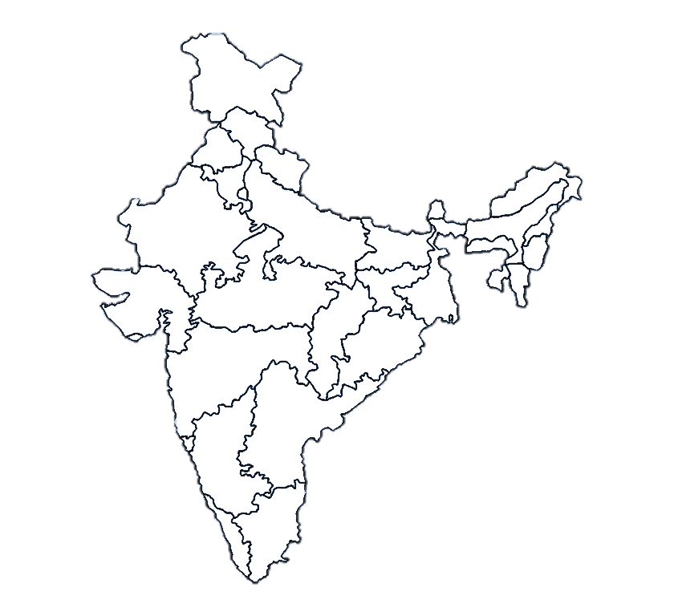
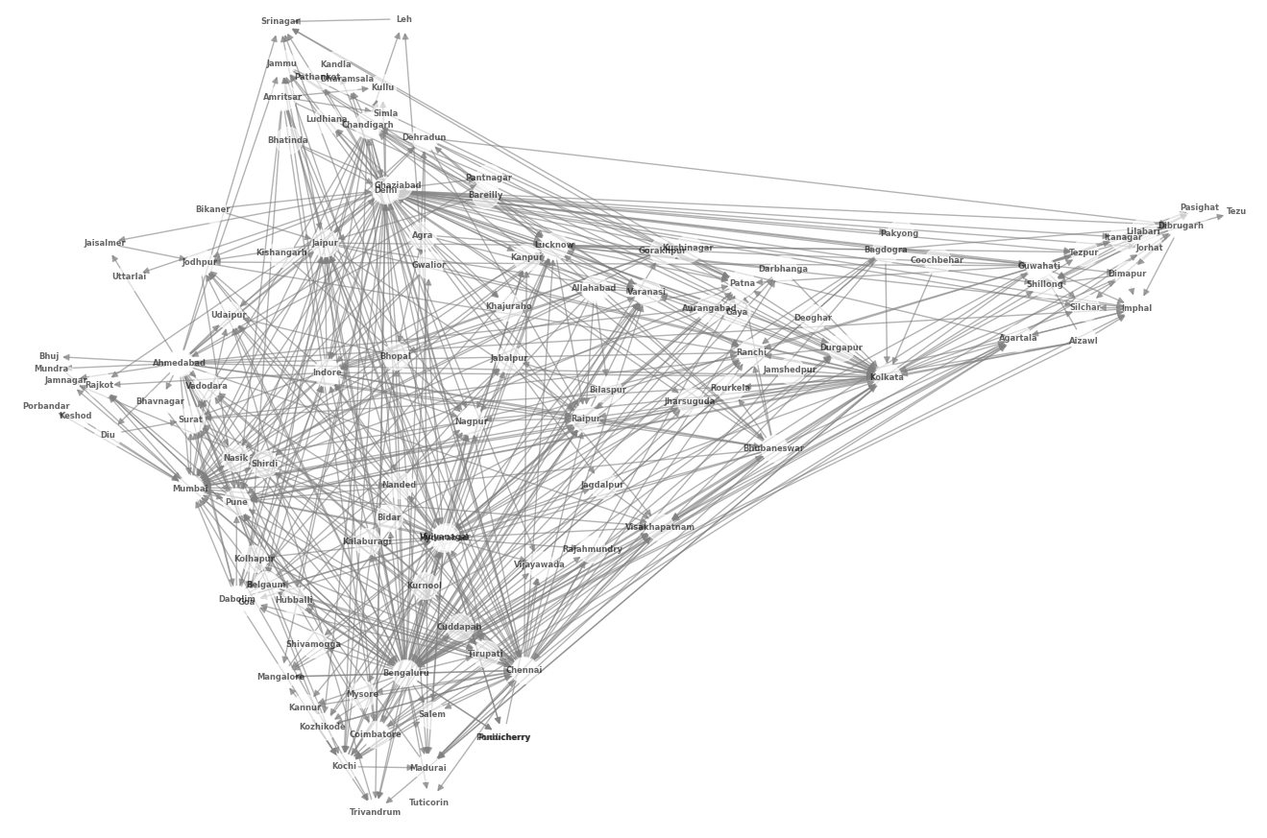
3.1.7. City Pair-wise Passenger Movement

Slide 29
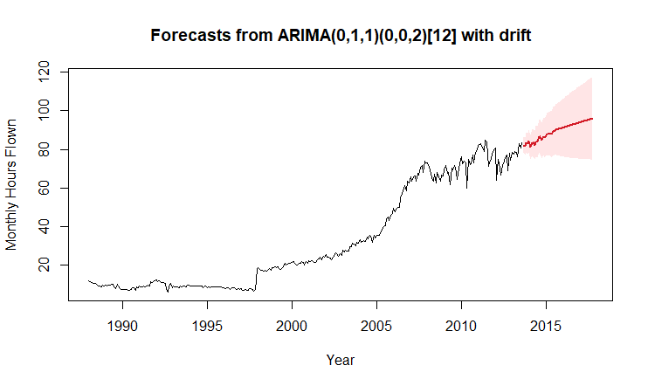
SARIMA
3.2.1. Overall Hours Flown
Data is forecasted from the year 2013 to 2018 here.
Increasing trend is present.
Seasonality is present.

Slide 30
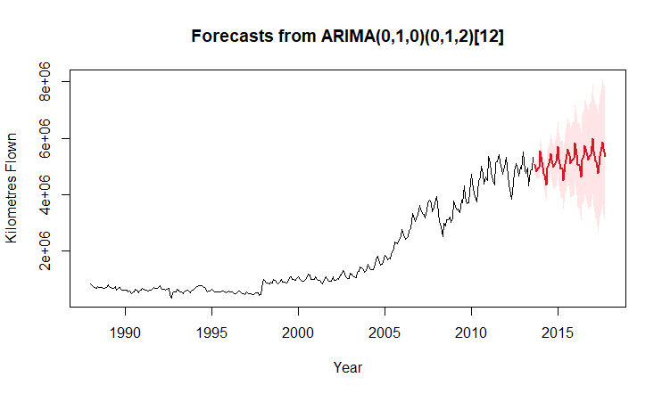
SARIMA
3.2.2. Overall Passenger Kilometres Flown
Data is forecasted from the year 2013 to 2018 here.
Increasing trend is present.
Seasonality is present.

Slide 31
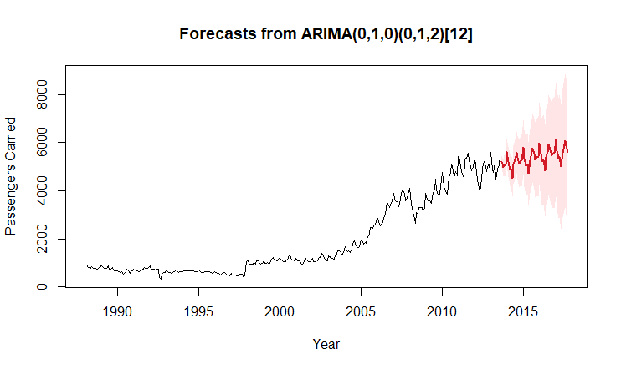
SARIMA
3.2.3. Overall Passengers Carried
Data is forecasted from the year 2013 to 2018 here.
Increasing trend is present.
Seasonality is present.

Slide 32
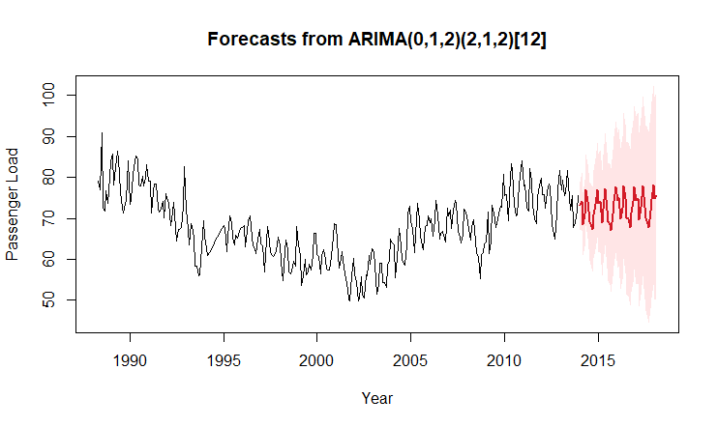
SARIMA
3.2.4. Overall Passenger Load Factor
Data is forecasted from the year 2013 to 2018 here.
No trend is present.
Seasonality is present.

Slide 33
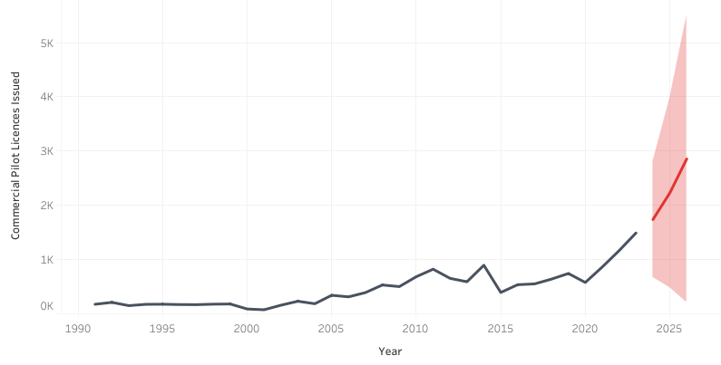
Line Chart
3.3.1. Overall Commercial Pilot Licences Issued
Data is forecasted from the year 2024 to 2026 here.
Increasing trend is present.
Overall growth of 118% in the last 14 years.

Slide 34
Stacked Bar Chart
3.3.2. Airline-wise Fleet Size
Increasing trend is present.
Overall growth of 86.6% in the last 10 years.
Average year on year growth rate 7.72% in the last 10 years.

Slide 35
Bar Chart
3.3.3. Aggregate Profit and Loss

Slide 36
Pie Chart
3.3.4. Airline-wise Market Share

Slide 37
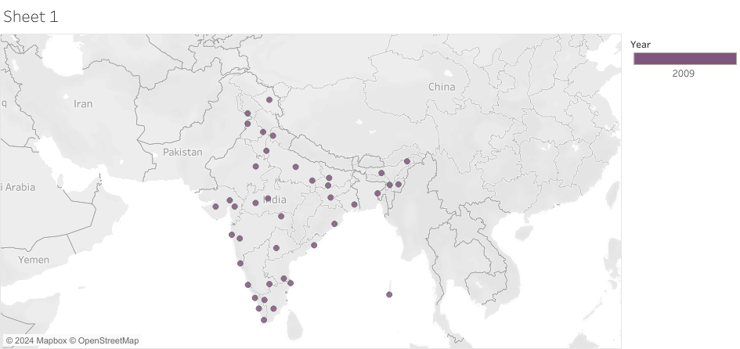
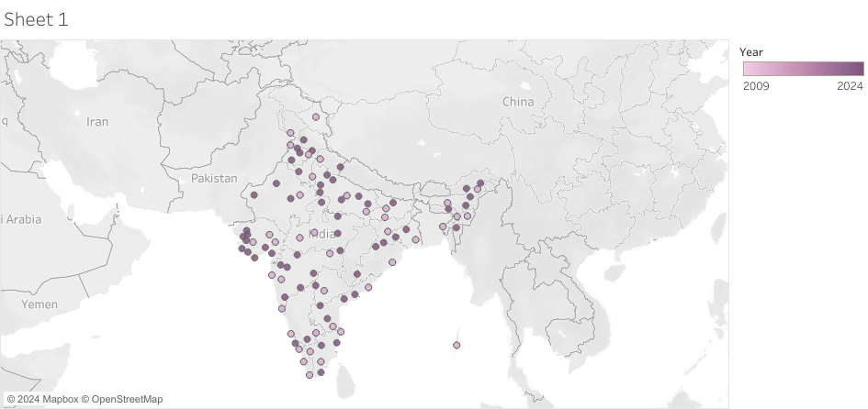
Symbol Map
3.3.5. Number of Airports in India
2009
2024

Slide 38
Hypothesis: There is no significant impact on the long term growth trajectory of the Indian Aviation Industry due to COVID-19 disruptions.
Component | Historical Data | Forecasted Data | Hypothesis
Pawan Hans Helicopters | ↓ | ↓ | Accepted*
Non-Pawan Hans Helicopters | — | — | Accepted
Hot Air Balloons | — | — | Accepted
Aircraft Movement | ↑ | ↑ | Accepted
Freight Movement | ↑ | ↑ | Accepted
Passenger Movement | ↑ | ↑ | Accepted

Slide 39
Conclusion
The time series analysis shows an upward trend in all segments of the Indian civil aviation industry, except for Pawan Hans Ltd. helicopters.
A notable decline occurred in the second quarter of 2020 due to COVID-19; however, most segments have since rebounded.
Current data aligns closely with the growth trend forecasted from pre-2020 data, within a 90% confidence interval, suggesting the industry has recovered as if the pandemic’s impact was temporary.
This long-term growth trajectory mirrors India’s GDP expansion, emphasising the aviation sector’s strengthening role in the economy.
The aviation industry's contribution to GDP has increased from 1.5% in 2009 to 2.4% in the late 2010s, reaching around 5% today.
These insights underscore the resilience of the aviation sector and its growing significance in India's economic landscape.

Slide 40
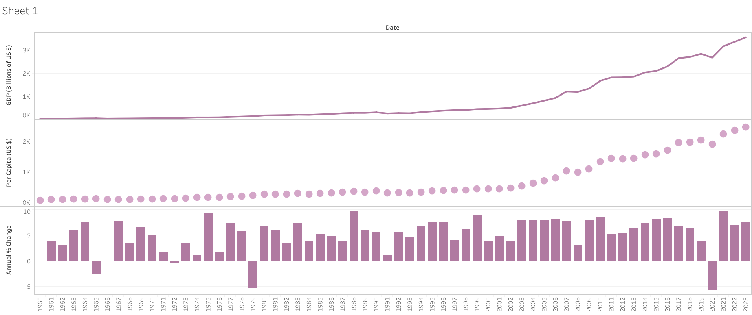
Conclusion
GDP Growth (1960-2023)
Year

Slide 41
Future Scope
Investigate the integration of macroeconomic indicators (e.g., fuel prices) and regulatory developments to enhance model robustness and predictive precision.
Explore the use of exogenous variables and structural breaks to improve the capture of external shocks in time series models.
Apply advanced machine learning (e.g., Random Forest, XGBoost) and deep learning (e.g., LSTM networks) to model non-numeric microeconomic factors for richer internal market insights.
Conduct granular trend analysis comparing regional airports and major hubs to identify growth prospects and untapped markets.
Study cross-sectoral data integration from hospitality and tourism to support network optimisation and regional trend analysis.

Slide 42
References
https://www-indiastat-com.svkm.mapmyaccess.com/data/transport -
https://www.macrotrends.net/global-metrics/countries/IND/IND/gdp-gross-domestic-product
https://www.forbes.com/sites/danielreed/2020/11/09/the-pandemic-is-forcing-big-airlines-to-make-profound-long-lasting-decisions-about-their-fleets/ -
http://www.knowindia.net/aviation7.html -
https://economictimes.indiatimes.com/industry/transportation/airlines-/-aviation/843-commercial-pilot-licences-issued-this-year-by-dgca/articleshow/11193883.cms?from=mdr -
https://www.ibef.org/research/case-study/rise-of-the-indian-aviation-market
https://tejimandi.com/blogs/feature-articles/indias-civil-aviation-industry-a-powerhouse-of-growth -
https://www.civilaviation.gov.in/sites/default/files/migration/moca_001320.pdf
Data Sources
News Articles

Slide 43
Thank you!

